Slide 1
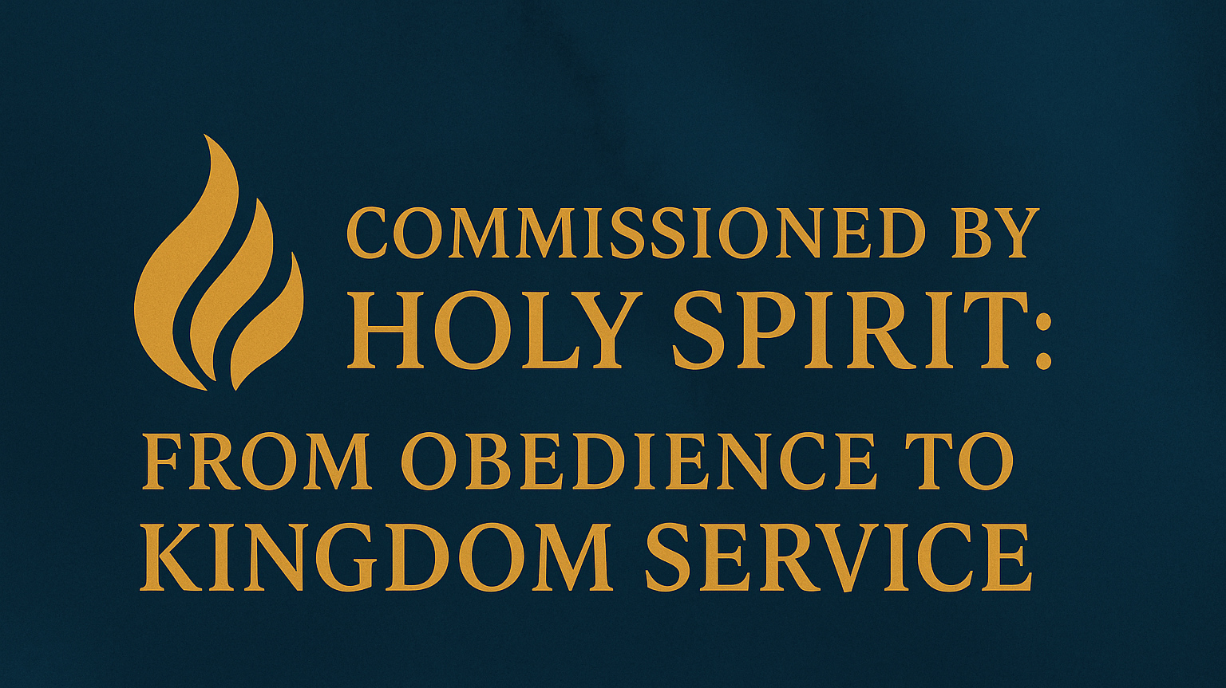

Slide 2

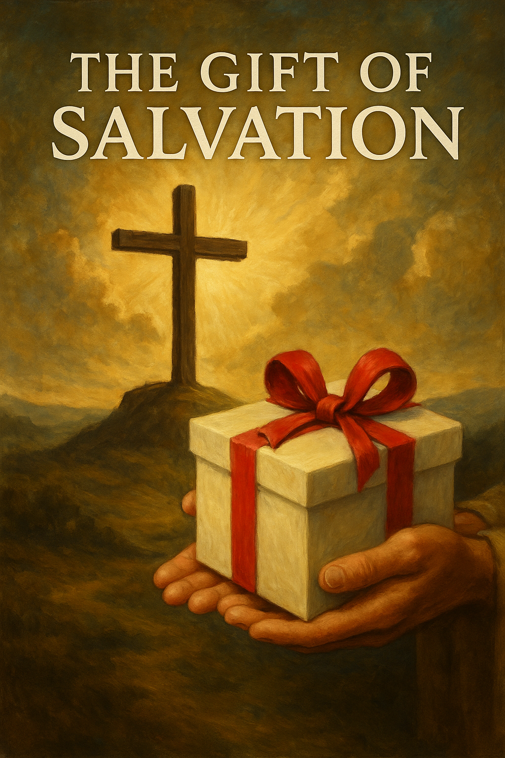

Kingdom Citizenship Involves Kingdom Work
1 Corinthians 15:58 (AMP)
Colossians 3:23–24 (AMP)
Matthew 9:37–38 (AMP)
Ephesians 2:10 (AMP)
John 9:4 (AMP)

Slide 3
The Holy Spirit’s Role in Our Calling
Acts 1:8
“You will receive power…”
The Spirit empowers our witness
Ephesians 4:30 (AMP)
“do not grieve the Holy Spirit of God [but seek to please Him]”
“by whom you were sealed and marked [branded as God’s own]”
The Spirit is the One who gives us power to obey, power to serve, and power to witness, just as Jesus promised

Slide 4
The Holy Spirit’s Role in Our Calling
Sending — empowered as witnesses (Acts 1:8)
Dedicated Service -- We are to serve the Lord with enthusiasm, diligence, and spiritual fervor, passionately advancing His Kingdom through our ministry (Romans 12:1-8, 11)
God doesn’t just strengthen you for personal blessing; He strengthens you to send you, to be His witness.
We are to passionately advance His Kingdom through our ministry.

Slide 5

God’s Pathway for Servants
Obedience
Sifting
Testing
Strengthening
Sending
saying yes to God’s rule
spiritual resistance (Luke 22:31–32)
proving your faith (Job 1–2)
restoration and equipping (John 21)
commissioned for Kingdom service (Acts 1:8)

Slide 6
God’s Pathway for Servants
When people sincerely submit to God and step into His service, opposition often follows
Satanic Resistance / Sifting
When believers submit to the Lord, Satan often demands to test them — to try to break their faith and disqualify them from their new assignment.
Biblical example: Peter
Luke 22:31–32 — “Simon, Simon, Satan has demanded to sift all of you like wheat…”
When someone steps closer to God’s mission, the enemy targets them to weaken or destroy that new commitment.

Slide 7
God’s Pathway for Servants
Testing / Refinement
God allows tests to refine and prove those who enter His service.
Biblical example: Job
Job 1–2 — Satan challenges Job’s faithfulness, and God permits a test, though He sets the boundaries.
Testing reveals true devotion and removes impurities in a servant’s heart.

Slide 8
God’s Pathway for Servants
Persecution / Physical Resistance
Following God as Lord often means encountering worldly opposition or persecution.
Biblical example: Paul
Acts 14:19 — Paul is stoned and left for dead after preaching the gospel.
Serving God may draw the hostility of people who reject Him.

Slide 9
God’s Pathway for Servants
Strengthening / Empowerment
After testing, those who endure usually receive greater spiritual authority and clarity.
Biblical example: Joseph
Genesis 39–41 — tested through betrayal and prison, then raised to lead Egypt
God uses the resistance to strengthen and position His servant for a greater mission.

Slide 10
God’s Pathway for Servants
Ongoing Dependence on God
Coming into service of the Lord means you cannot succeed alone — the resistance drives you to rely on God continually.
Biblical example: Moses
Exodus 3–4 — protested his weakness, but God showed “I AM with you.”
We learn to lean on God’s power, not our own.

Slide 11
God’s Pathway for Servants
Historically and biblically, when a person says:
“Jesus is Lord; I will serve Him,”
we should expect testing, sifting, and even persecution — but these trials, under God’s sovereignty, become the very means by which we are strengthened, proven, and positioned to carry out our purpose.

Slide 12
God’s Pathway for Servants -- Summary
Stage # | Stage | What Happens | Biblical Examples
1 | Commitment to serve God | Declaring “yes” to His Lordship | Moses, Peter, Paul
2 | Satanic sifting / resistance | Enemy tries to shake or disqualify | Job, Peter
3 | Testing / trials | Faith refined and proven | Joseph, Abraham
4 | Strengthening / empowerment | God grants greater authority | Joseph, David, Paul
5 | Deeper dependence on God | Learning to trust Him daily | Moses, Gideon

Slide 13

How This Applies to New Water

Slide 14
How This Applies to New Water
We are here on purpose
Drawn by the Holy Spirit
We have gifts to serve
Expect testing
Trust God’s strengthening
Step boldly into Kingdom service

Slide 15
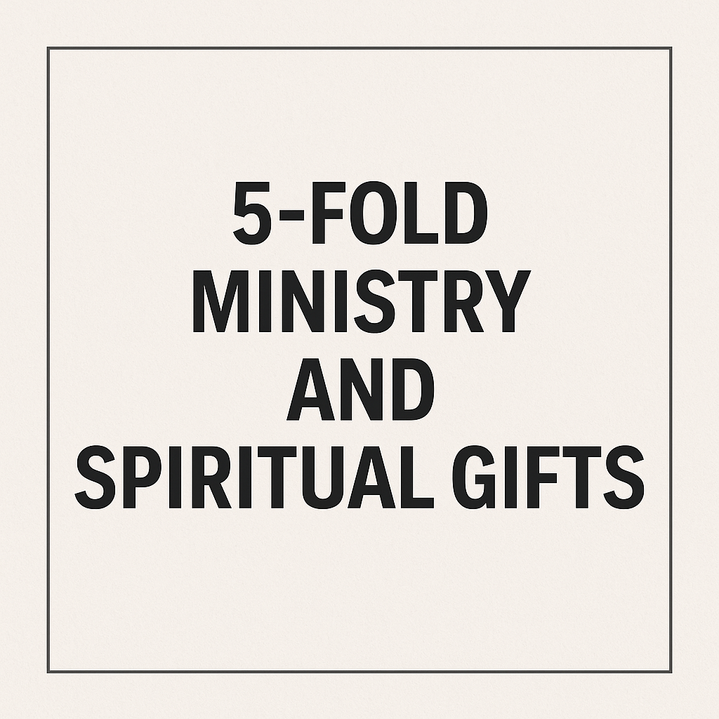
Your Call to Action -- Step into your Kingdom assignment
“For we are His workmanship, created in Christ Jesus for good works…” (Ephesians 2:10)

Slide 16
The Five-Fold Ministry (Ephesians 4:11-12)
Distinct leadership roles in the Church, each with unique functions and skill requirements.
Apostle
Prophet
Evangelist
Pastor (Shepherd)
Teacher
How has the Holy Spirit commissioned you?

Slide 17
Five-Fold Role | Primary Role | Key Responsibilities | Skill Requirements
Apostle | Pioneering, foundation-laying, overseeing multiple ministries | Establishing new churches, Apostolic oversight and governance, Equipping and mentoring leaders, Ensuring doctrinal integrity, Cross-cultural or international missions | Strong visionary leadership, Church planting & organizational development, Spiritual discernment & wisdom, Networking & collaboration, Resilience & adaptability
Prophet | Hearing and communicating God’s heart and direction | Delivering prophetic words (edification, exhortation, comfort), Discerning spiritual strongholds and deception, Intercession, Assisting in decision-making through revelation | Deep prayer & intimacy with God, Accuracy in prophecy, Discernment of spirits, Humility & accountability, Encouragement & confrontation
Evangelist | Proclaiming the Gospel and leading people to salvation | Preaching in various settings, Training believers in evangelism, Following up with new converts, Mobilizing outreach | Powerful preaching & communication, Soul-winning passion, Relational skills, Adaptability, Basic apologetics
Pastor (Shepherd) | Caring for, guiding, and nurturing a local congregation | Teaching sound doctrine, Counseling and guidance, Discipling and developing leaders, Ensuring church health and unity | Compassionate leadership, Strong teaching ability, Conflict resolution, Administrative skills, Emotional intelligence
Teacher | Explaining Scripture clearly and ensuring sound doctrine | Teaching in various contexts, Providing theological clarity and refuting error, Creating study materials, Mentoring others | Deep biblical knowledge, Clear communication, Critical thinking, Patience, Research skills

Slide 18
Spiritual Gift | Scripture Reference | Brief Description
Prophecy | Romans 12:6, 1 Cor. 12:10 | Speaking messages from God to edify, exhort, or comfort
Teaching | Romans 12:7, 1 Cor. 12:28 | Explaining God’s Word with clarity and accuracy
Exhortation (Encouragement) | Romans 12:8 | Motivating, encouraging, and strengthening others
Leadership (Governance) | Romans 12:8 | Leading, organizing, and directing ministries
Giving | Romans 12:8 | Generously providing resources to advance God’s kingdom
Mercy | Romans 12:8 | Showing compassion and care to those in need
Serving (Helps) | Romans 12:7, 1 Cor. 12:28 | Providing practical support to others and to the ministry
Faith | 1 Cor. 12:9 | Having extraordinary confidence in God’s power and promises

Slide 19
Spiritual Gift | Scripture Reference | Brief Description
Healing | 1 Cor. 12:9 | God working through someone to bring physical, emotional, or spiritual healing
Miracles | 1 Cor. 12:10 | God performing supernatural acts through a person
Discernment of Spirits | 1 Cor. 12:10 | Distinguishing between true and false spiritual influences
Tongues | 1 Cor. 12:10 | Speaking in unknown languages as enabled by the Holy Spirit
Interpretation of Tongues | 1 Cor. 12:10 | Interpreting messages spoken in tongues for the benefit of the Church
Word of Wisdom | 1 Cor. 12:8 | Applying divine insight and solutions to situations
Word of Knowledge | 1 Cor. 12:8 | Supernatural understanding of facts and truth beyond natural ability
Apostleship | 1 Cor. 12:28, Eph. 4:11 | Pioneering and establishing new works for the Gospel
Pastoring (Shepherding) | Eph. 4:11 | Caring for and nurturing a congregation

Slide 20
Five-Fold Role | Closely Related Spiritual Gifts | How They Work Together
Apostle | Leadership, Faith, Wisdom, Administration, Miracles | Apostles build, govern, and oversee new works; they need gifts of faith, leadership, wisdom, and often miracles to establish foundations and break new ground
Prophet | Prophecy, Discernment, Word of Knowledge, Word of Wisdom | Prophets hear and declare God’s messages; they rely on the prophetic gift, deep discernment, and revelation gifts to guide the church
Evangelist | Evangelism, Faith, Healing, Miracles | Evangelists proclaim Christ and call people to salvation; they often operate with gifts of faith, healing, and miracles to confirm the gospel
Pastor (Shepherd) | Shepherding, Teaching, Mercy, Exhortation, Discernment | Pastors nurture and protect God’s people, using gifts of shepherding, encouragement, teaching, and discernment to build healthy congregations
Teacher | Teaching, Knowledge, Wisdom, Prophecy | Teachers explain and protect sound doctrine, using gifts of teaching, knowledge, and wisdom to make Scripture clear and guard truth

Slide 21
New Water Ministry Needs | Related Spiritual Gifts | How They Apply
Children’s Church | Teaching, Exhortation, Shepherding, Helps | Teaching children Bible truths, encouraging their faith, nurturing, assisting with lessons and care
Usher Board | Helps, Hospitality, Leadership, Discernment | Welcoming guests, organizing flow, discerning spiritual atmosphere, making people feel safe
Security | Leadership, Discernment, Helps | Keeping order, recognizing spiritual threats, serving practically
Music (Vocal/Instrumental) | Prophecy, Exhortation, Worship, Creativity | Leading worship, encouraging the congregation, releasing prophetic praise, using creative gifts
Housekeeping | Helps, Administration, Hospitality | Keeping God’s house in order, stewarding resources, creating a welcoming space
Media | Knowledge, Communication, Helps, Wisdom | Communicating the gospel effectively, technical support, wise messaging
Language Translation | Interpretation, Knowledge, Evangelism, Helps | Breaking language barriers, accurately conveying Scripture, helping evangelize cross-culturally
Hospitality | Hospitality, Helps, Mercy, Encouragement | Welcoming guests warmly, showing mercy, caring for needs, encouraging connection
Dance | Prophecy, Worship, Creativity, Exhortation | Using movement to prophetically worship, creatively express God’s message, encouraging the audience
Outreach | Evangelism, Mercy, Apostleship, Helps | Spreading the gospel, showing compassion, pioneering new outreach, serving needs of the community

Slide 22
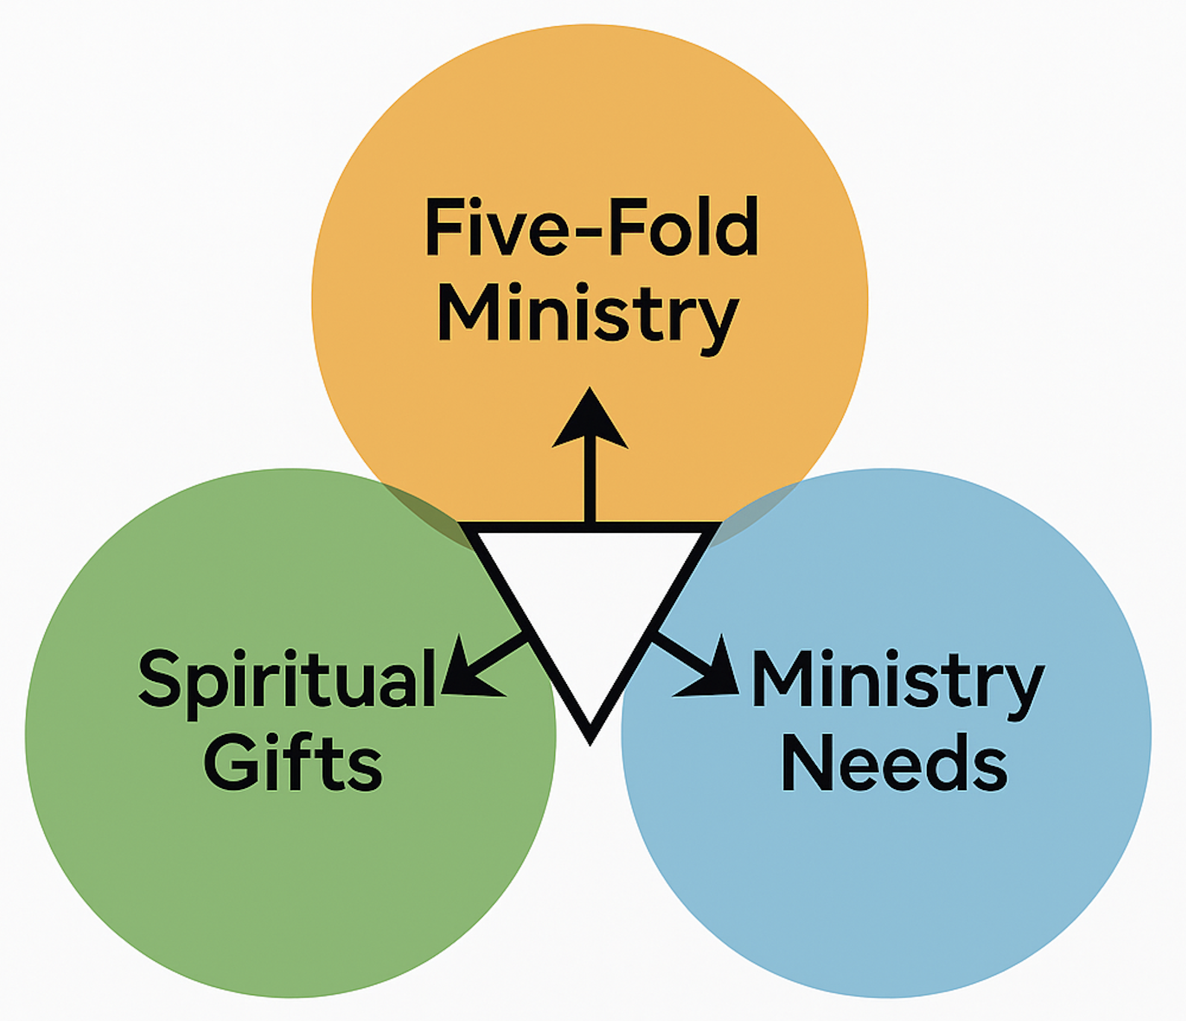
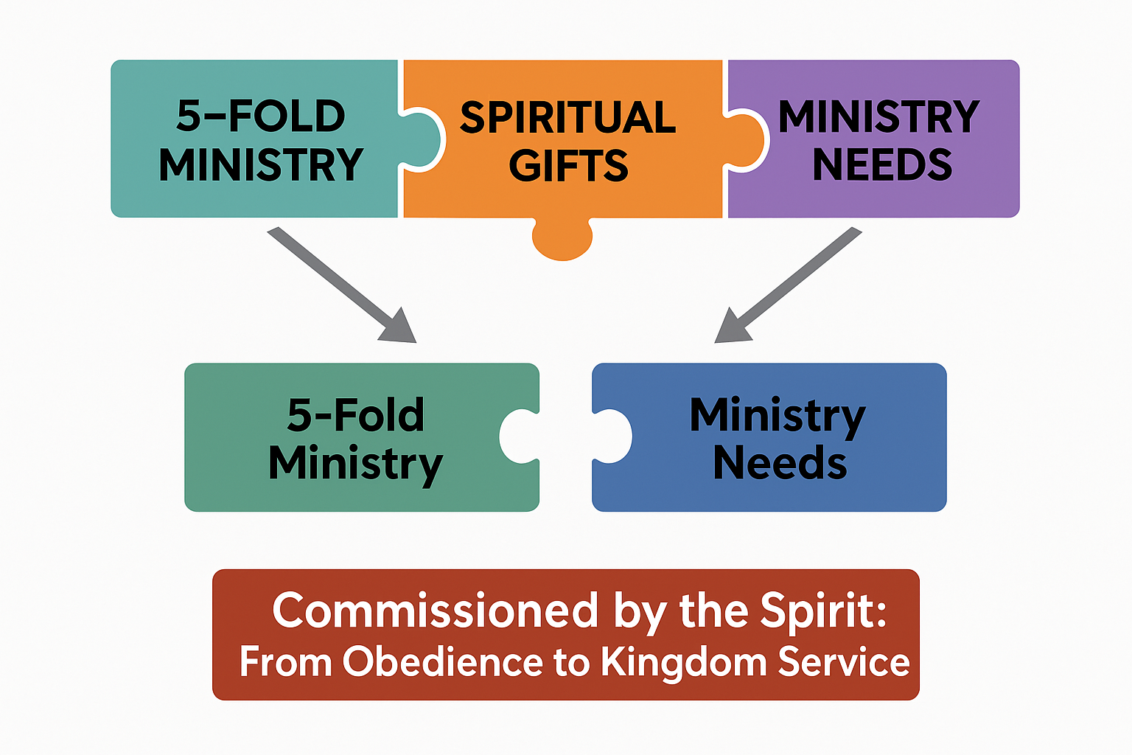

Slide 23

Questions?

