Slide 1
The dispensational lens is a theological framework that views biblical history as divided into distinct periods or “dispensations,” each marked by a different way God interacts with humanity. It’s especially influential in interpreting prophecy and eschatology (end-times theology), and it undergirds ideas like the Rapture, the Tribulation, and the Millennial Kingdom.
Here’s a breakdown tailored to your ministry context
What Is the Dispensational Lens?
Seven Dispensations (classic view):
  Innocence (Adam before the Fall)
  Conscience (Adam to Noah)
  Human Government (Noah to Abraham)
  Promise (Abraham to Moses)
  Law (Moses to Christ)
  Grace (Church Age)
  Kingdom (Millennial reign of Christ)

Slide 2
. THE TESTIMONY OF HEAVENLY BEINGS.
Acts 1:10-11. "And while they looked steadfastly toward heaven as he went up, behold, two men stood by them in white apparel; which also said, Ye men of Galilee, why stand ye gazing up into heaven? This SAME JESUS, which is taken up from you into heaven, shall so come IN LIKE MANNER as ye have seen him go into heaven."
This passage declares that the SAME JESUS shall return IN LIKE MANNER as He went, that is, that His return will be visible and personal. The two "men" that "stood by" were probably Moses and Elijah. They appeared with Jesus on the Mount of Transfiguration. They were doubtless the "two men" who testified to the women at the tomb that Jesus had risen (Luke 24:4-5), and they will be the "Two Witnesses" that shall testify during the Tribulation. Rev. 11:3-12.

Slide 3
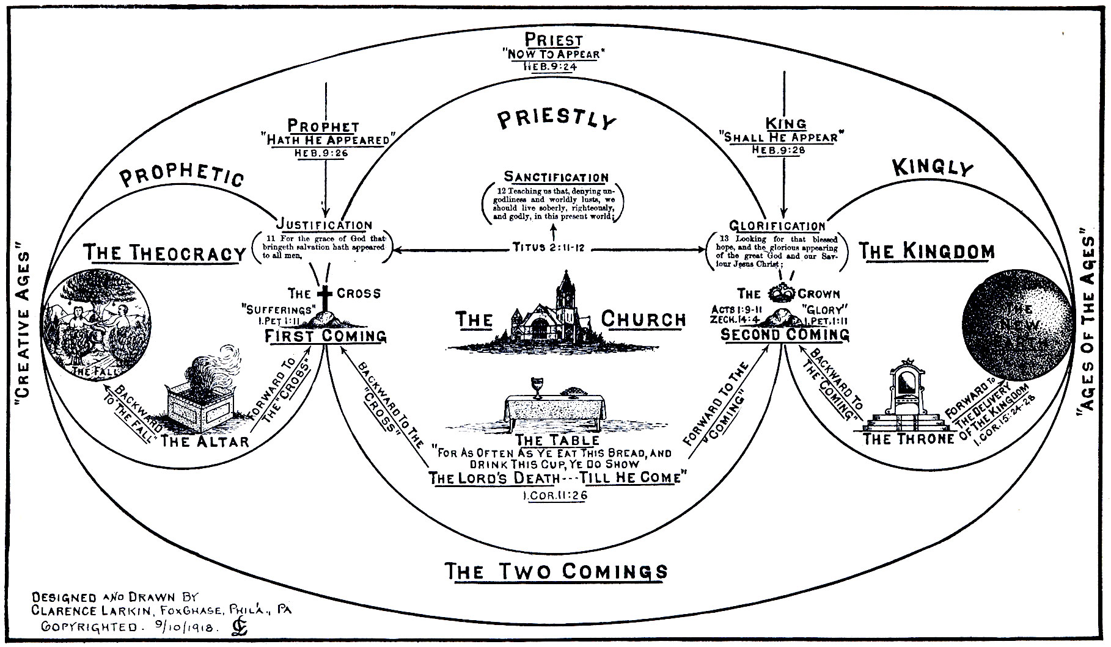

Slide 4
THE SECOND COMING
AS TO THE FACT
THE TESTIMONY OF JESUS HIMSELF.
Matt 16:27. "For the Son of Man shall come in the glory of his Father, with his angels, and then he shall reward every man according to his works."
Matt. 25:31-32. "When the Son of Man shall come in his glory, and all the holy angels with him, then shall he sit upon the 'Throne of His Glory;' and before him shall be gathered all nations; and he shall separate them one from another, as a shepherd divideth his sheep from the goats."
John 14:2-3. "In my father's house are many mansions; if it were not so I would have told you. I go to prepare a place for you. And if I go and prepare a place for you I will come again, and receive you unto myself; that where I am, there ye may be also."
John 21:22. "If I will that he tarry till I come what is that to thee? Follow thou me."

Slide 5
THE TESTIMONY OF THE APOSTLES
PAUL- Phil. 3:20-21 "For our conversation is in heaven; from whence also we look for the Saviour, the Lord Jesus Christ: (21) who shall change our vile body, that it may be fashioned like unto his glorious body, according to the work to the working whereby he is able even to subdue all things unto himself."
Titus 2:13.
"Looking for that 'Blessed Hope' and the 'Glorious Appearing' of the great God and our Saviour Jesus Christ."
Heb. 9:28.
"So Christ was once offered to bear the sins of many; and unto them that look for him shall he appear the 'Second Time' without sin unto salvation."
James 5:7 "Be patient therefore, brethren, unto the coming of the Lord."
2 Peter 2:16 PETER-"For we have not followed cunningly devised fables when we made known unto you the power and coming of our Lord Jesus Christ, but were eye-witnesses of his majesty."
2 Pet.1:16.

Slide 6
2 Pet.1:16 For we have not followed cunningly devised fables, when we made known unto you the power and coming of our Lord Jesus Christ, but were eyewitnesses of his majesty.
Peter here refers to the Transfiguration of Christ on the Mount (Matt. 17:1-5), which was a type of His Second Coming.
Moses was a type of the "resurrection saints," and Elijah of those who shall be translated without dying. Peter, James and John were a type of the Jewish Remnant that shall see Him when He comes, and the remaining disciples at the foot of the mount, unable to cast the demon out of the boy, of those professed followers of Jesus who shall be left behind at the Rapture, and who shall be powerless to cast the demons out of the demon-possessed people of that period.
Jude 14-10 And Enoch also, the seventh from Adam, prophesied of these, saying, Behold, the Lord cometh with ten thousand of his saints, to execute judgment upon all, and to convince all that are ungodly among them of all their ungodly deeds which they have ungodly committed, and of all their hard speeches which ungodly sinners have spoke against him." 1 John 2:28.
And now, little children, abide in him; that, when he shall appear, we may have confidence, and not be ashamed before him at his coming
Rev. 1:7. Behold, he cometh with clouds; and every eye shall see him, and they also which pierced him: and all kindreds of the earth shall wail because of him. Even so, Amen."

Slide 7
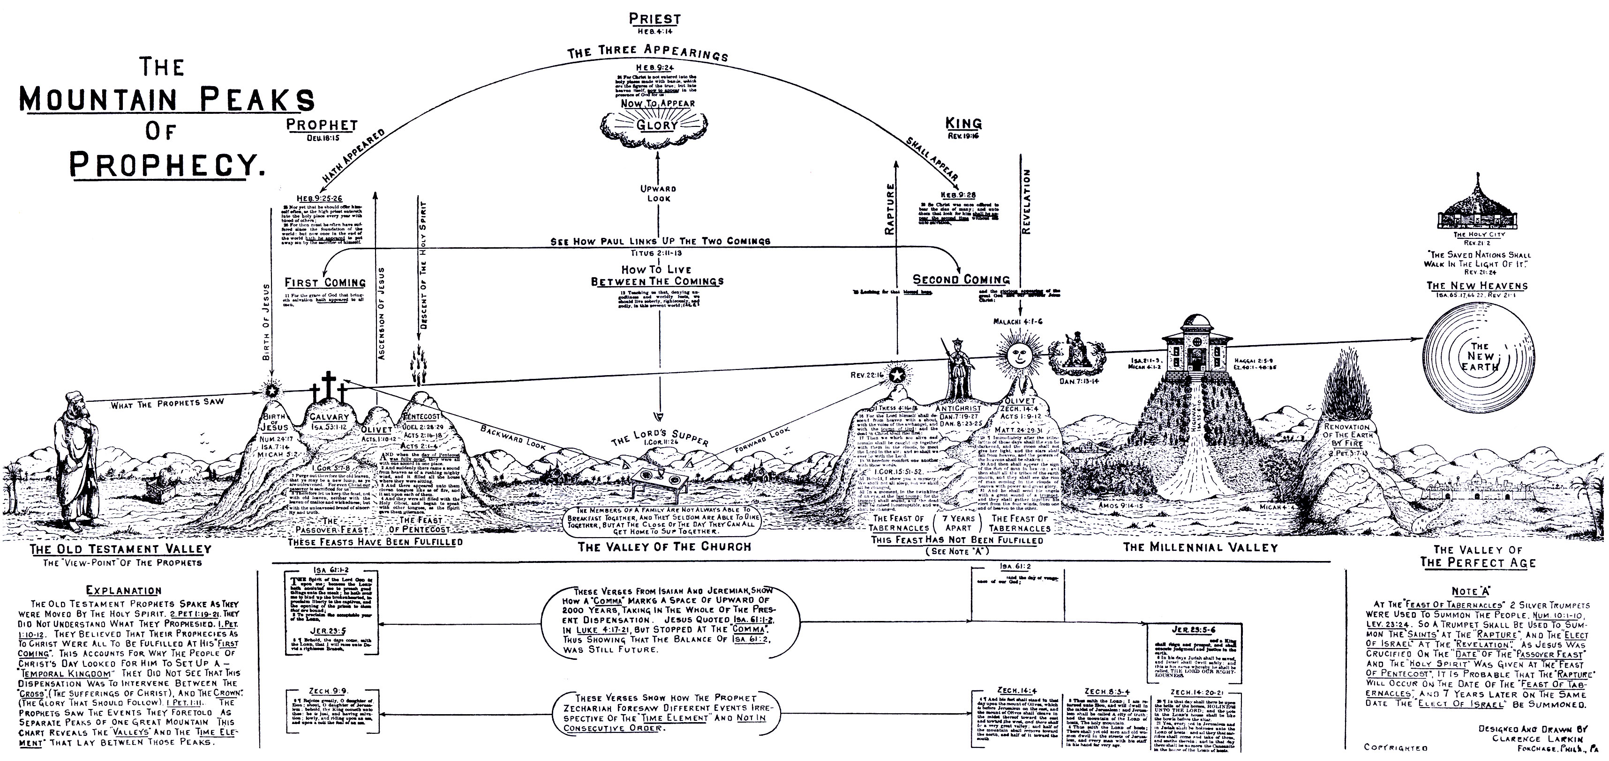

Slide 8
THE TESTIMONY OF THE LORD'S SUPPER.
Cor. 11:26.For as often as ye eat this bread, and drink this cup, ye do show the Lord's death till He come."
The Lord's Supper is not a permanent ordinance. It will be discontinued when the Lord returns. It is a Memorial Feast. It looks back to the "Cross" and forward to the "Coming." An engagement ring is not intended to be permanent. It is simply a pledge of mutual love and loyalty, and gives place to the wedding ring. So the Lord's Table may be looked upon as a betrothal pledge left to the Church during the absence of her betrothed.
Paul in all his epistles refers but 13 times to Baptism, while he speaks of the Lord's return 50 times. One verse in every 30 in the New Testament refers to Christ's Second Coming. There are 20 times as many references in the Old Testament to Christ's Second Coming as to His First Coming.

Slide 9
What Happens to the Church Between the First and Second Coming?
In dispensational theology, the First Coming refers to Christ’s incarnation, death, and resurrection. The Second Coming refers to His return in glory to establish the Millennial Kingdom. Between these two events lies the Church Age, the Rapture, and the Tribulation.
1. Church Age (Pentecost to Rapture)
Purpose: Evangelism, discipleship, and preparation for Christ’s return.
Scripture:
  Matthew 28:19–20 – “Go ye therefore, and teach all nations…”
  Acts 2 – Birth of the Church at Pentecost.
  Ephesians 3:10–11 – The Church reveals God’s manifold wisdom.
Understanding: This is the age of grace, where salvation is offered freely through faith in Christ. The Church is empowered by the Holy Spirit to be salt and light.

Slide 10
2. Rapture (Before Tribulation)
Event: Christ comes for His Church, removing believers from the earth.
Scripture:
  1 Thessalonians 4:16–17 – “The dead in Christ shall rise first…”
  1 Corinthians 15:51–52 – “In a moment, in the twinkling of an eye…”
Understanding: The Rapture is a rescue and reward for the faithful. It marks the end of the Church Age and the beginning of the Tribulation.

Slide 11
3. Tribulation (7 Years of Judgment)
Event: A time of global upheaval, spiritual deception, and divine judgment.
Scripture:
  Daniel 9:27 – The final “week” of years.
  Revelation 6–19 – Seals, trumpets, bowls of wrath.
Understanding: The Church is absent, but some will come to faith during this time—often at great cost. These are the “Tribulation saints” (Revelation 7:14).

Slide 12
4. Second Coming (Return in Glory)
Event: Christ returns with His saints to defeat evil and establish His Kingdom.
Scripture:
  Revelation 19:11–16 – “Faithful and True…King of Kings.”
  Zechariah 14:4 – His feet shall stand on the Mount of Olives.
Understanding: The Church returns with Christ, now glorified, to reign with Him during the Millennium.

Slide 13
What Happens to Unbelievers in the Same Period?
1. During the Church Age
Status: Offered salvation but remain spiritually dead.
Scripture:
  John 3:18 – “He that believeth not is condemned already.”
  Ephesians 2:1–3 – “Dead in trespasses and sins.”
Understanding: Unbelievers are invited into grace but resist. Their spiritual blindness persists unless they repent.

Slide 14
2. After the Rapture
Status: Left behind, vulnerable to deception and judgment.
Scripture:
  2 Thessalonians 2:10–12 – “God shall send them strong delusion…”
  Matthew 25:1–13 – Foolish virgins unprepared.
Understanding: Many will be deceived by the Antichrist. Some may come to faith, but most will face wrath and spiritual confusion.

Slide 15
3. At the Second Coming
Status: Judged and excluded from the Kingdom.
Scripture:
  Revelation 19:20 – “The beast was taken…cast alive into a lake of fire.”
  Matthew 25:31–46 – Sheep and goats judgment.
Understanding: Unbelievers are judged according to their rejection of Christ and their deeds. Eternal separation follows.

Slide 16
Pastoral Application
This timeline isn’t just theological—it’s deeply pastoral. It calls the Church to:
Urgency in outreach: The Rapture could happen at any moment.
Clarity in teaching: Many professing believers may not be truly prepared.
Compassion for the lost: Even those left behind may yet be reached.

